Slide 1
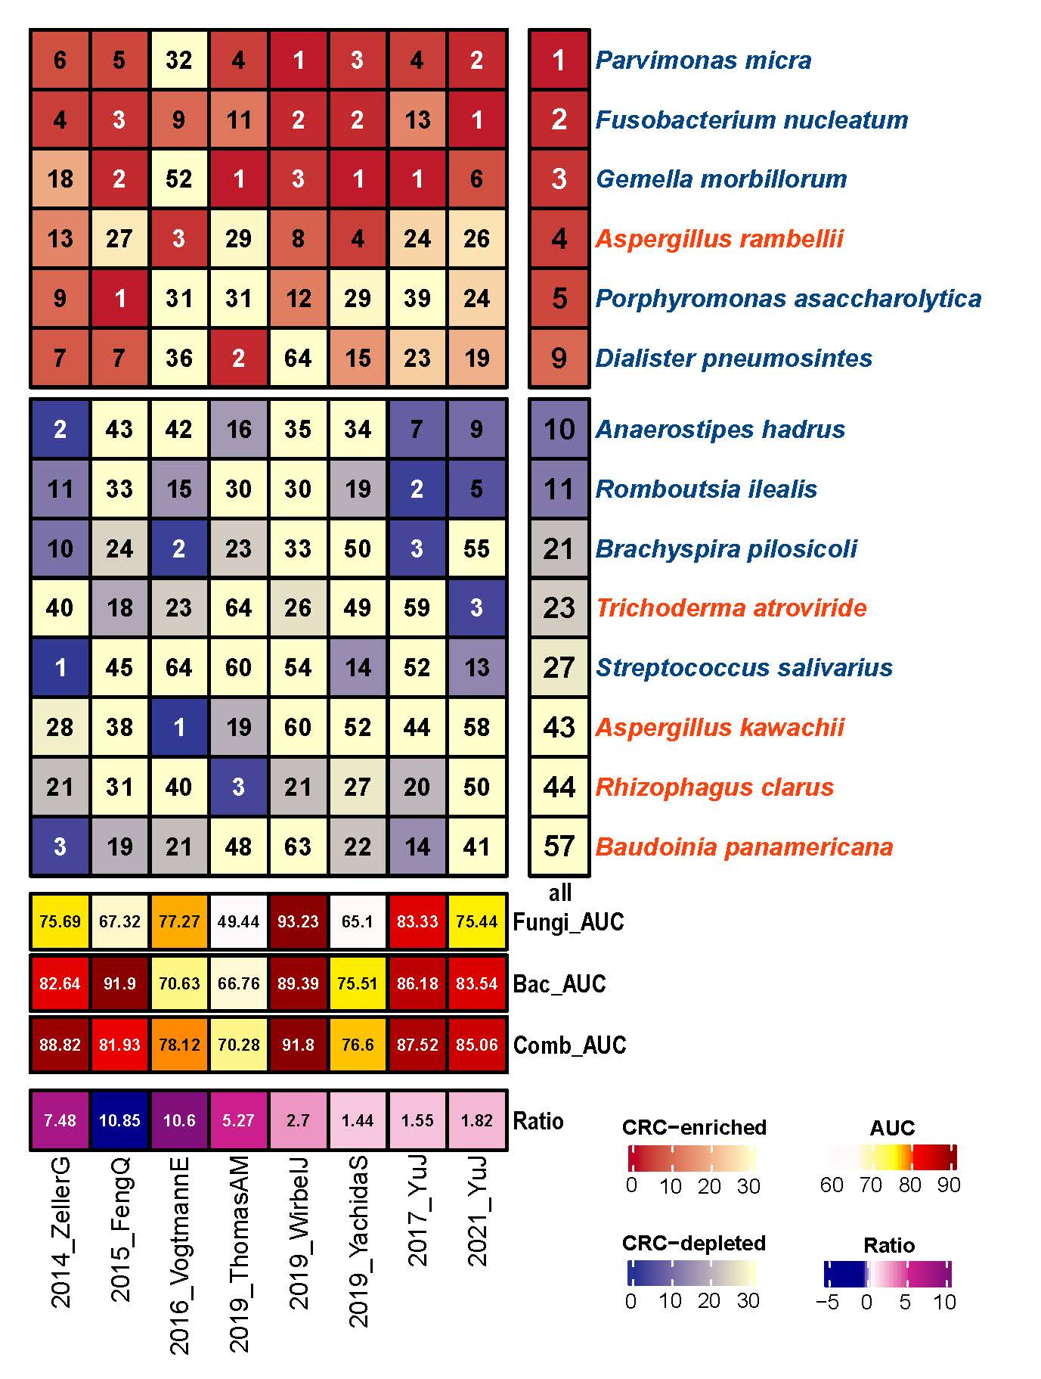
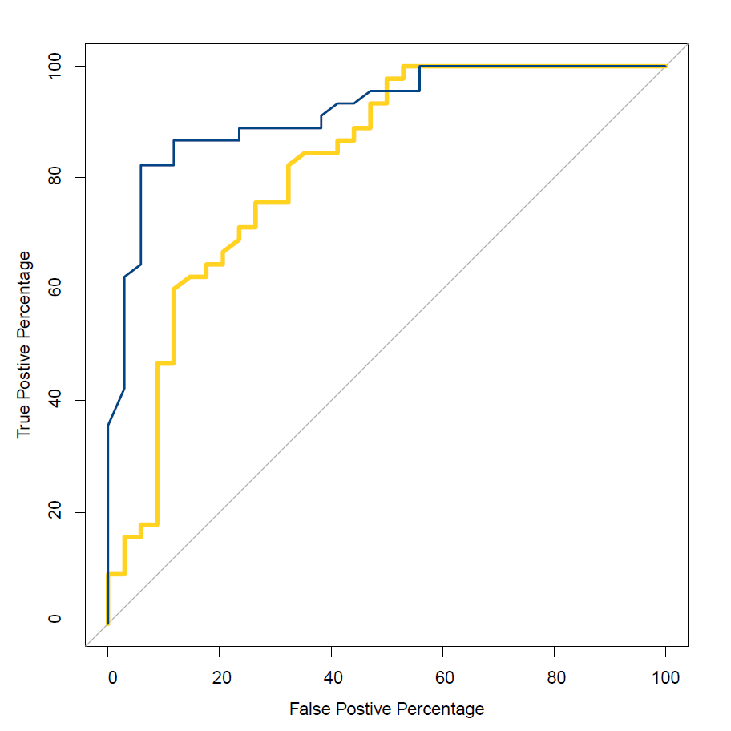
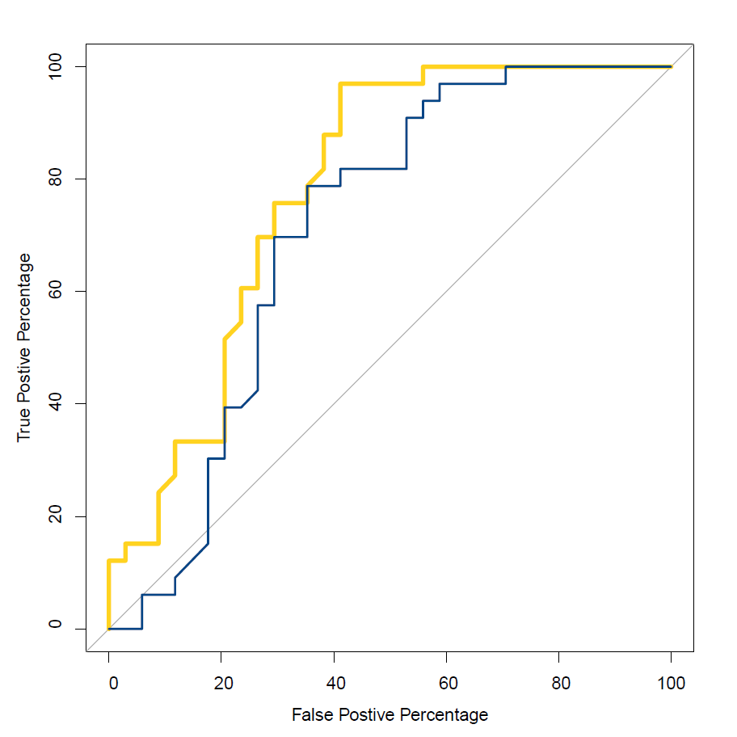
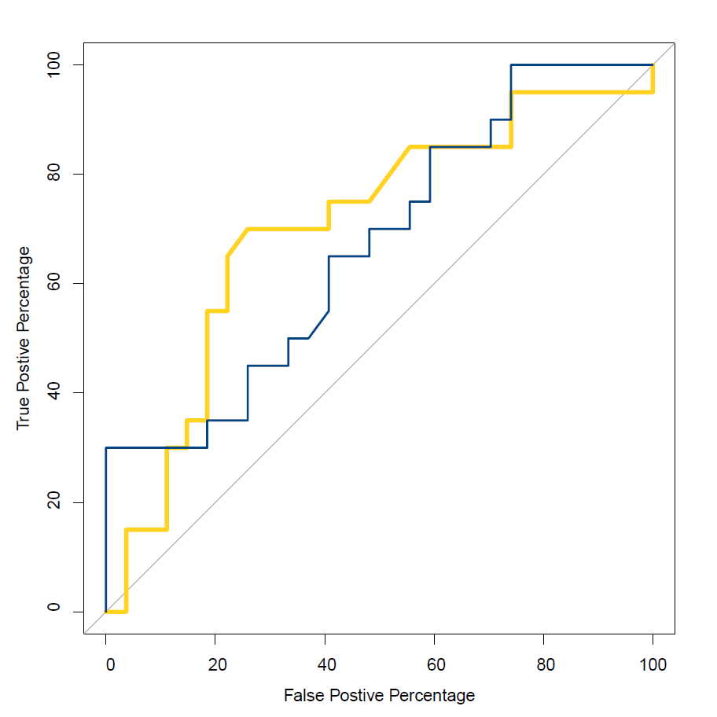
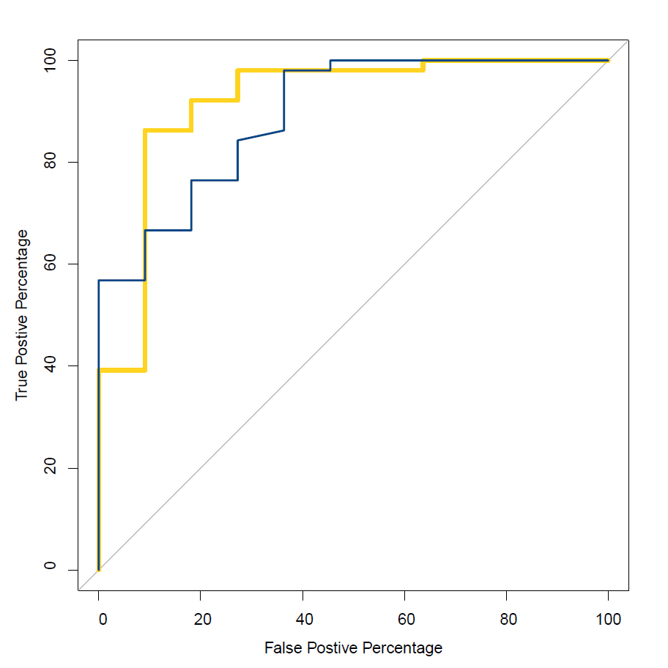
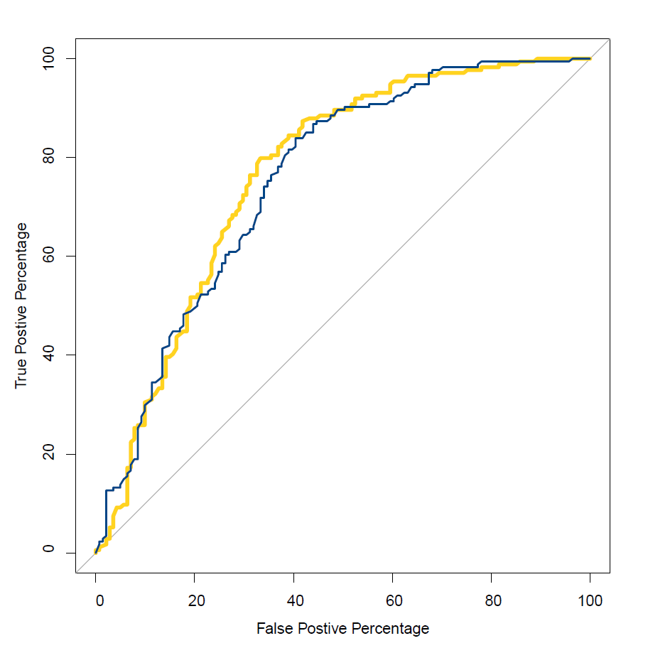
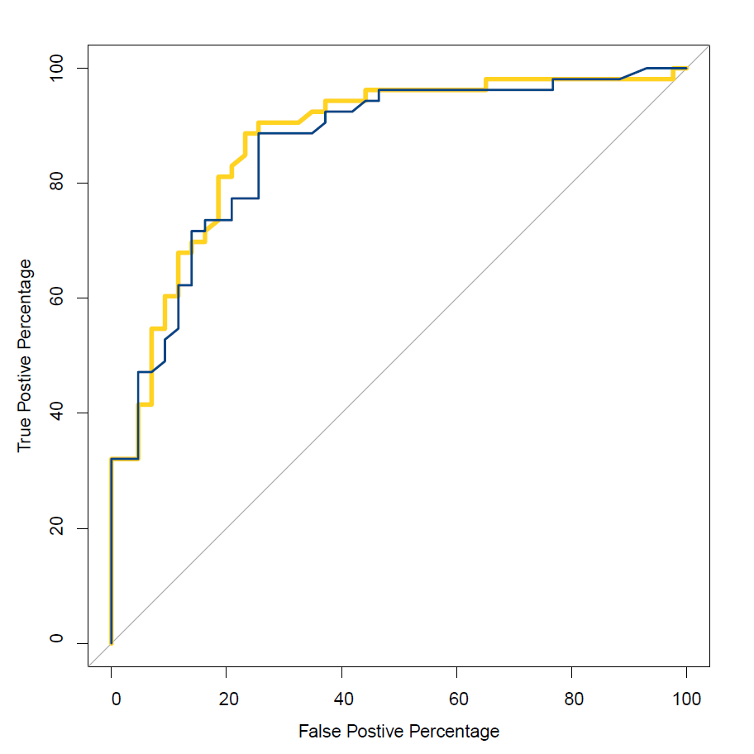
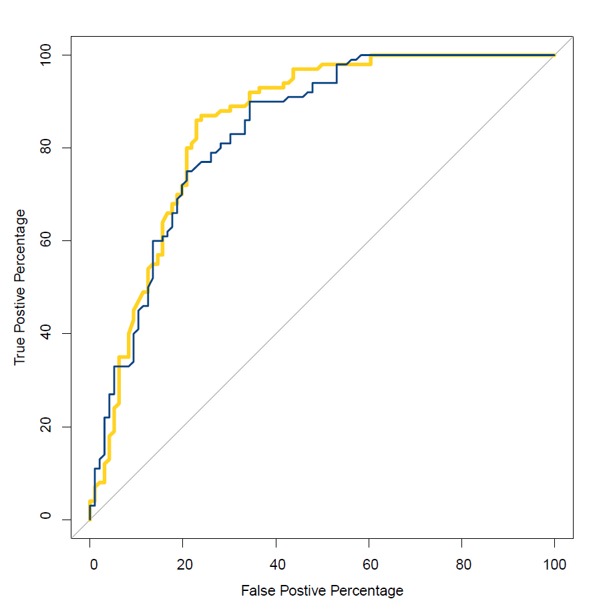


Figure 7
a
b
AUC in different cohorts with LOSO
Random forest feature ranking
2014_ZellerG (EU)
2015_FengQ (OC)
Bac AUC = 82.64%
Comb AUC = 88.82%
Bac AUC = 91.9%
Comb AUC = 81.93%
2016_VogtmannE (NA)
2019_ThomasAM (EU)
Bac AUC = 70.63%
Comb AUC = 78.12%
Bac AUC = 66.76%
Comb AUC = 70.28%
2019_WirbelJ (EU)
2019_YachidaS (AS)
Bac AUC = 89.39%
Comb AUC = 91.80%
Bac AUC = 75.51%
Comb AUC = 76.60%
2017_YuJ (AS)
2021_ YuJ (AS)
$$\frac{{AUC}_{Comb}−{AUC}_{Bac}}{{AUC}_{Bac}}$$
Bac AUC = 86.18%
Comb AUC = 87.52%
Bac AUC = 83.54%
Comb AUC = 85.06%

